Slide 1
Pre-lecture 9 and 10: Multilevel modelling How to read design formula syntax
Notes:
Hi everyone, this week we’re going to be talking more about multilevel modelling – this is a quick recap and explainer of how each of these models is written in r’s design formula syntax. This is not essential material for acing the course, but it might at least vaguely interest some of you, and I think it will help you understand what we’re doing with MLM

Slide 2
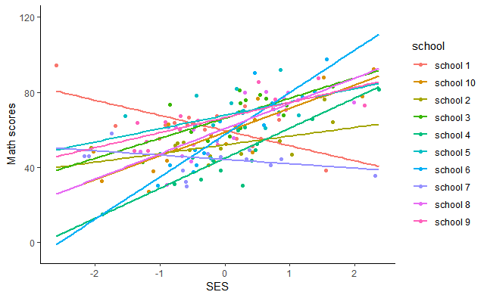
Our eventual regression model
Y_{ij} = γ₀₀ + γ₁₀x_{ij} + u_{0j} + u_{1j}x_{ij} + ε_{ij}
math ~ 1 + ses + (1 + ses | school)
Notes:
We’re going to work our way back up to this model here, and by the end of this video you will, with a bit of luck, be able to read both of these equations. The top is the more traditional way of writing this, the bottom is R’s design formula syntax

Slide 3
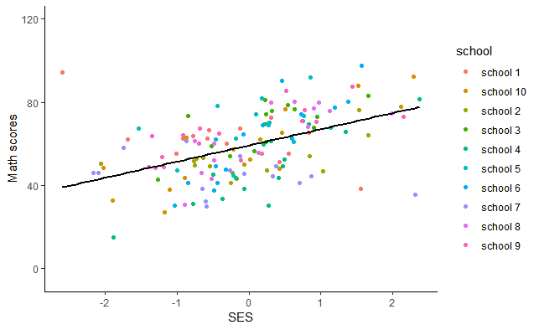
Simple regression model
Y_{ij} = β₀ + β₁₀X_{ij} + ε_{ij}
math ~ 1 + ses
Notes:
We’re going to start off thinking just of simple regression. I’m going you can see we are predicting y, math scores, with an intercept, a regression coefficient time X, SES, and we include an error term as our predictions will not be perfect. In r’s syntax, this is simply written as math ~ (tilde, basically we just just think “equals” 1 (which is indicative of the intercept, here in green) plus SES, in red. In r’s design formula syntax we can just ignore the error term

Slide 4
Simple regression model
Notes:
We can run this in r after reading in our data using the lm command, which just runs simple regression Here I save the model as mod 1, say that math is predicted by ses, and here I add in an intercept, even though it’s not strictly necessary, and also tell the function that my data is called “mathDat”. After running the function and saving it as mod1, we can take a look at the output by running the summary function on mod1. So, we can see that a one unit increase in SES leads to a 7.8 unit predicted increase in math scores, from an intercept of 59.1

Slide 5
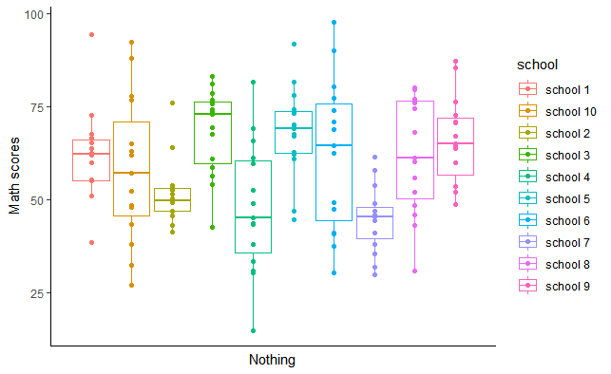
Random effects ANOVA
Y_{ij} = γ₀₀ + γ₁₀x_{ij} + u_{0j} + u_{1j}x_{ij} + ε_{ij}
math ~ 1 + (1 | school)
Notes:
In random effects ANOVAs we’re only interested in whether the overall scores differ by group – Notice that there is nothing on the y axis, there’s no regression slope, just gamma 00 an overall intercept, and a random effect / a random intercept for group. So here, in r’s syntax, we just write math ~ 1 (for the intercept) + open brackers, 1 bar school, close brackets. We’re saying that for each school, we allow the intercept to vary.

Slide 6
Random effects ANOVA
Y_{ij} = γ₀₀ + γ₁₀x_{ij} + u_{0j} + u_{1j}x_{ij} + ε_{ij}
math ~ 1 + (1 | school)
Notes:
In random effects ANOVAs we’re only interested in whether the overall scores differ by group – Notice that there is nothing on the y axis, there’s no regression slope, just gamma 00 an overall intercept, and a random effect / a random intercept for group. So here, in r’s syntax, we just write math ~ 1 (for the intercept) + open brackers, 1 bar school, close brackets. We’re saying that for each school, we allow the intercept to vary.

Slide 7
Running a random effects ANOVA in R
Notes:
We can run this model in R using the lme4 linear mixed effects models packahe, and getting statistical tests and some other accoutrement using lmerTest. Then we can run this model, saying math is predcited by an intercept plus a random effect for school – i.e., letting the intercepts differ by school, saving it as mod2, and then get a model summary using the summary function Good, well we can see some nice output there, but maybe we want to take a look at the ICC – we can either use the sjstasts package to get the ICC function to get the icc with the icc function, which you can see here. The icc is the proportion of variance attributable to the grouping structure as a proportion of the total variance .22 is pretty high, so the grouping structure is important indeed. Although we should probably be doing this on non-data driven grounds based on how the data was generated, this gives us more even more certaintly that we should account for the grouping in running our analysis
We could also have just calculate it by hand – you can see just copying and pasting from above gets us the same answer after accounting for rounding .

Slide 8
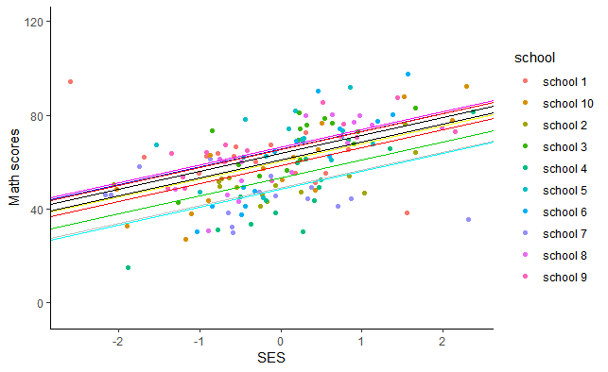
Random intercepts model
Y_{ij} = γ₀₀ + γ₁₀x_{ij} + u_{0j} + ε_{ij}
math ~ 1 + ses + (1 | school)
Notes:
A random intercepts models assumes the slope is the same for everyone, but lets the intercepts differ by group. We can see this is math score for person I in group j = gamma 00 (an intercept for everyone) + gamma 10 times a person’s score on ses (a regression slope for person) + a random effect for each group + a residual for each person The only new part in the random slopes model is that we have the regression slope for the relationship between SES and math scores

Slide 9
One regression model
Y_{ij} = γ₀₀ + γ₁₀x_{ij} + u_{0j} + u_{1j}x_{ij} + ε_{ij}
y ~ 1 + ses + (1 + ses | school)
Notes:
If we use traditional regression we are almost certainly violating one of the major assumptions of regression – that variables are independently and identically distributed – the nested sampling means that individuals from the same school are not independent of one another. The schools probably have some impact on the Math scores of the kids, and there are also almost certainly differences between schools in the average level of SES.

